Slide 1

IAI大數據競賽訓練
03-高頻收據特徵擷取
講師：楊甯雅

Slide 2
Agenda
資料清洗
特徵擷取

Slide 3
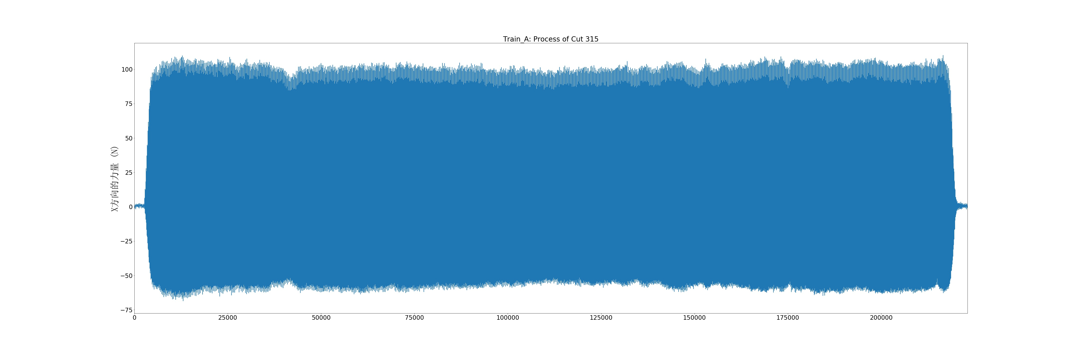
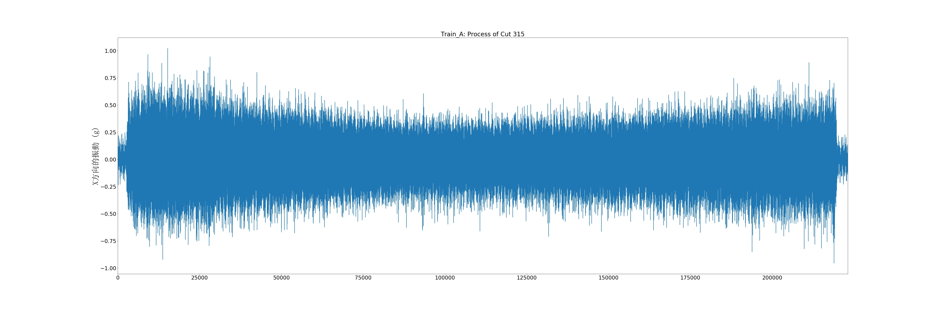
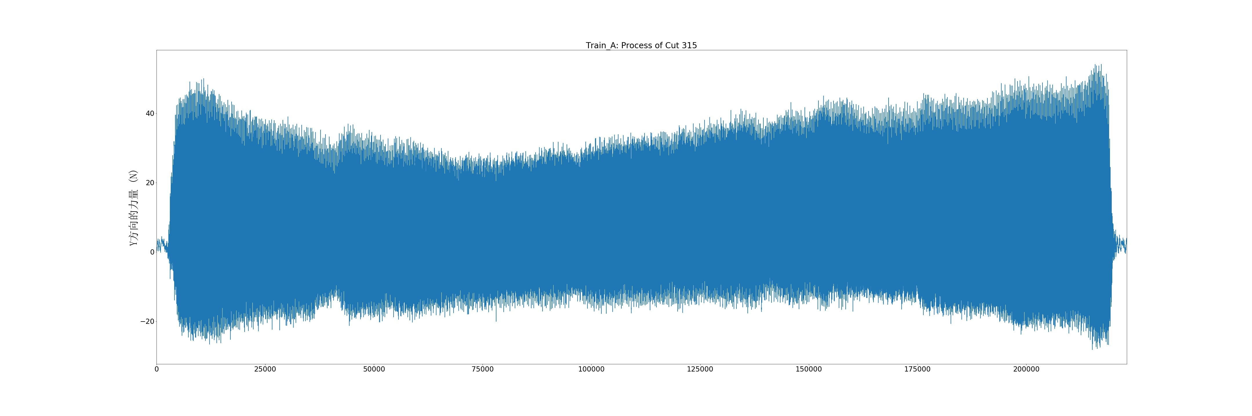
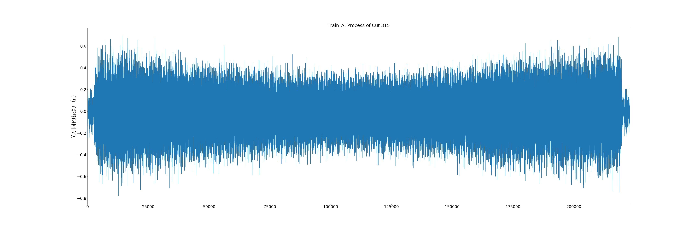
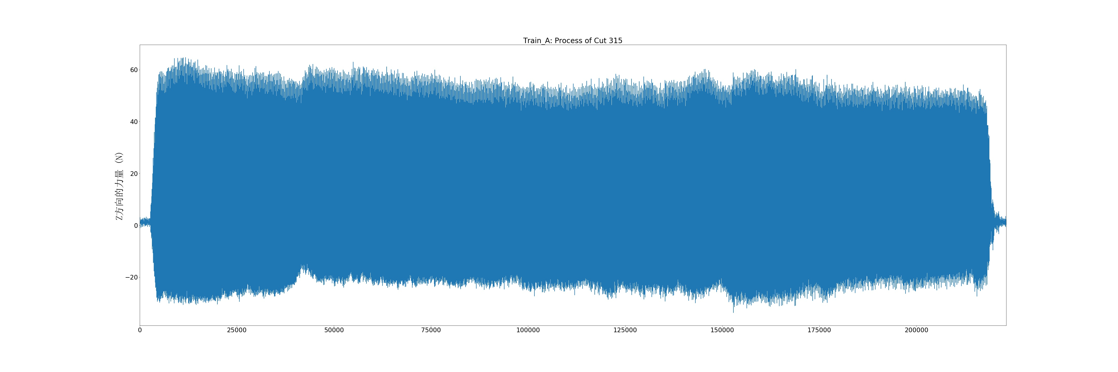
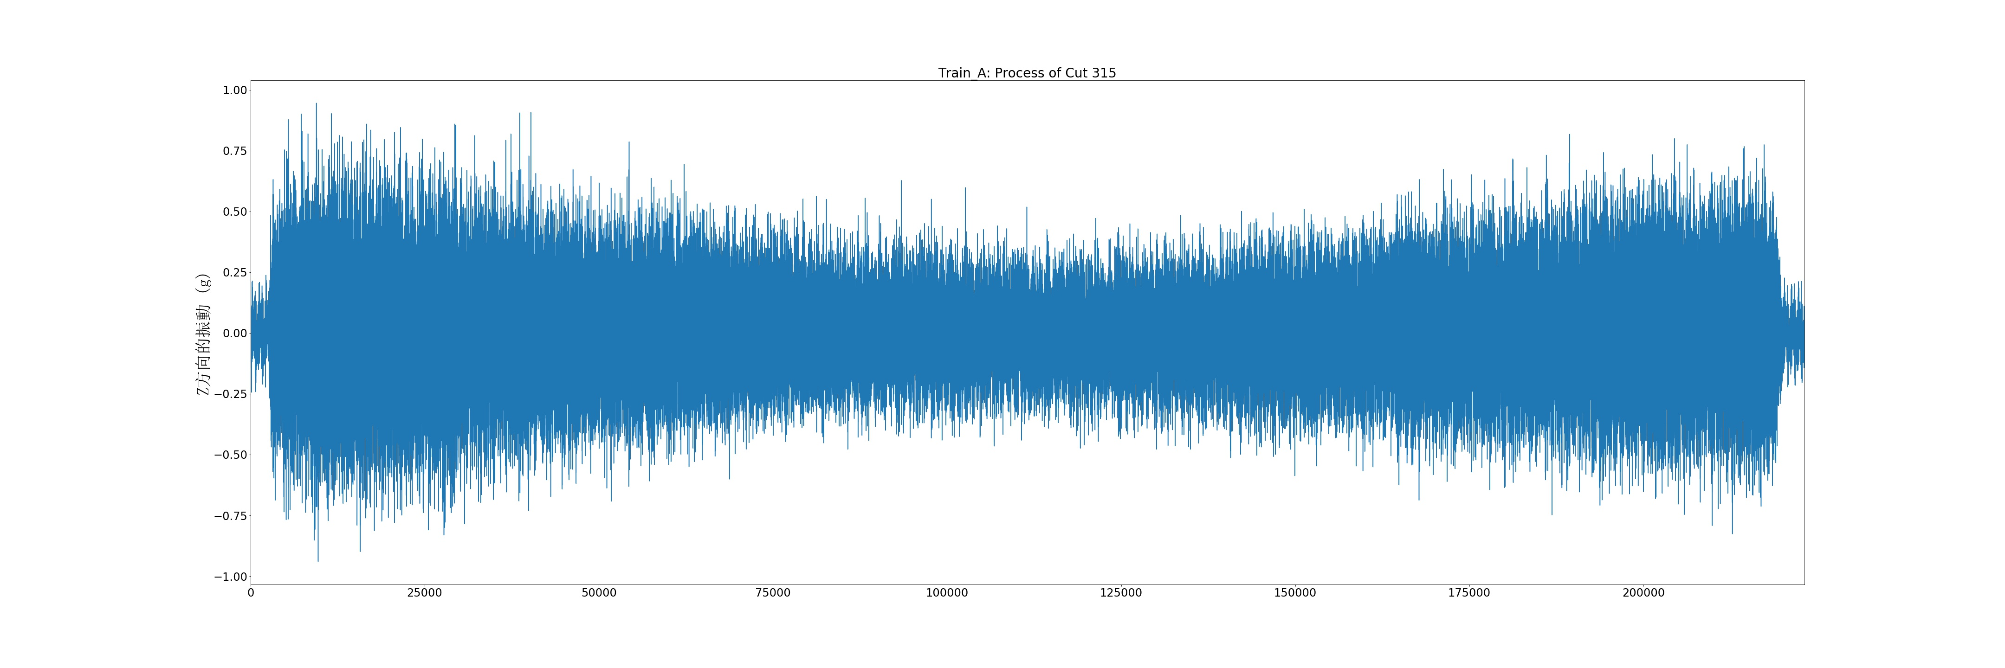
資料清洗
X方向的力量
X方向的振動
Y方向的力量
Y方向的振動
Z方向的力量
Z方向的振動

Slide 4
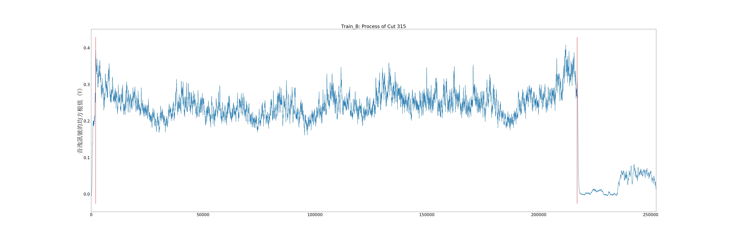
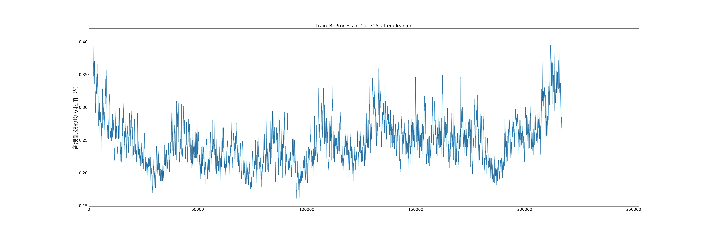
資料清洗
cut315 for instance
before
after
Train B
清除未作動數據，並記錄下資料取值起始點與結束點

Slide 5
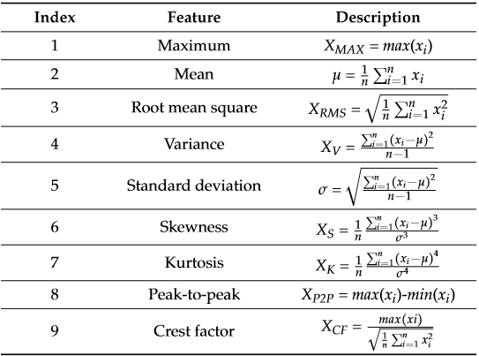
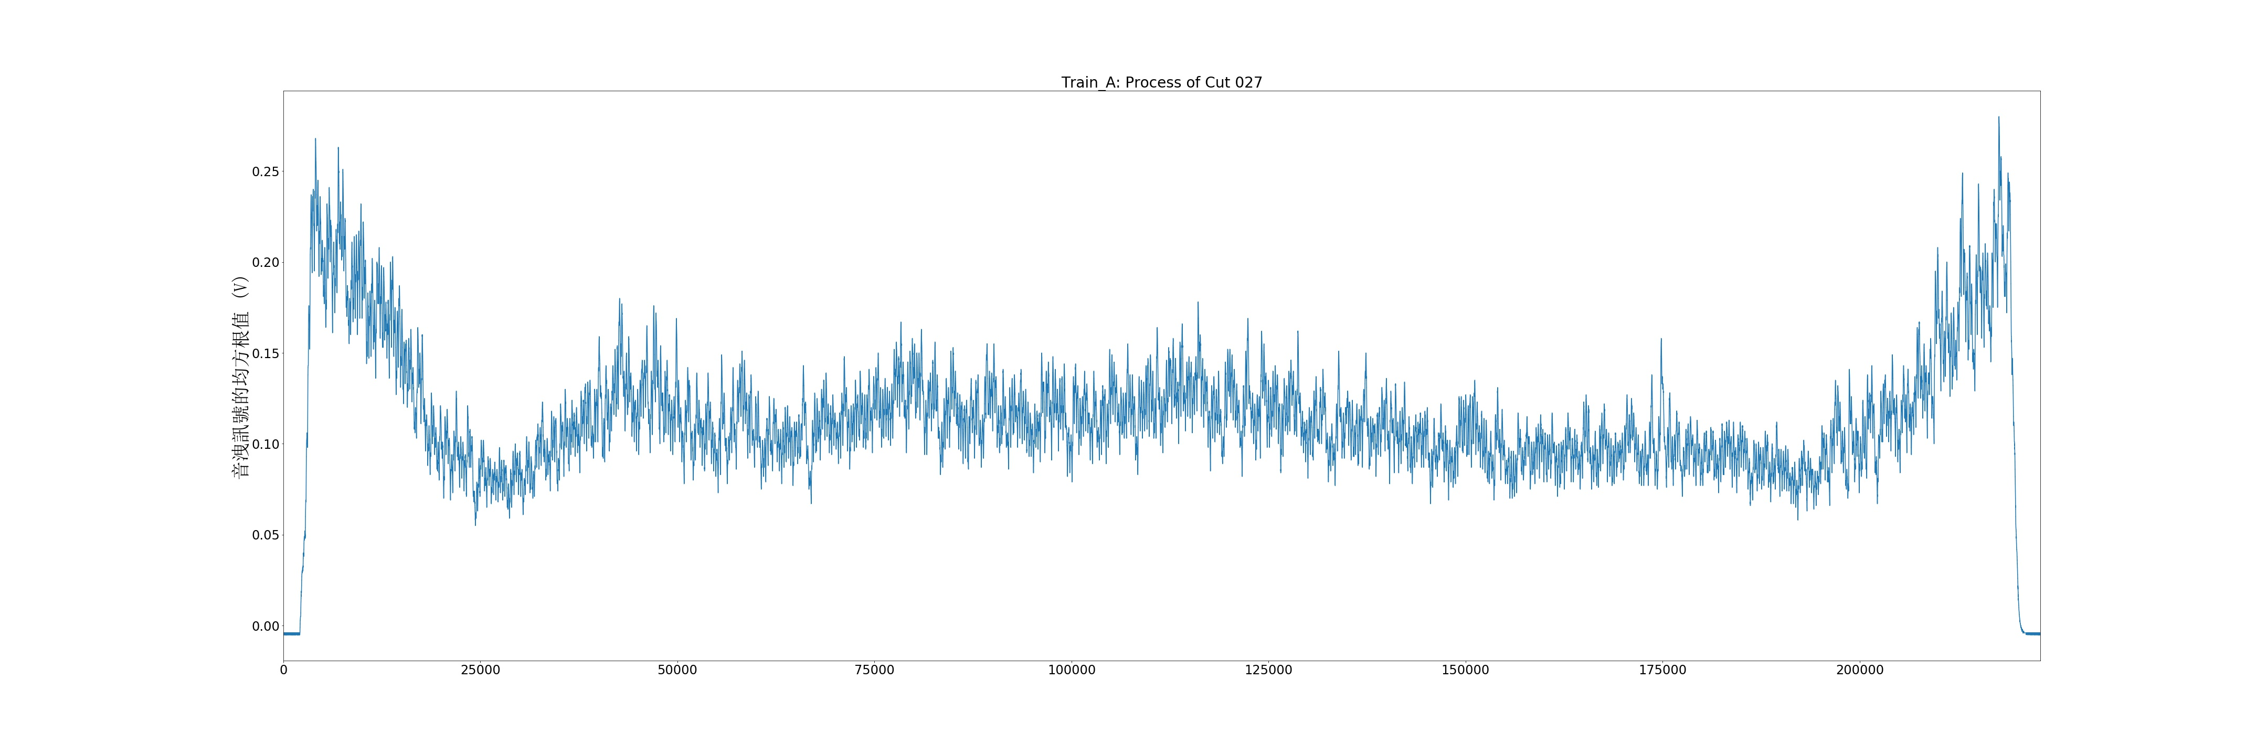
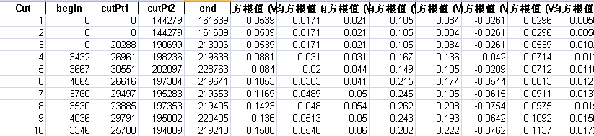
特徵擷取-time domain
Feature Extraction & Selection(for音洩訊號):
1
2
3
Feature Extraction & Selection(for音洩訊號):
1.將音洩訊號均方根值切割出三個step
2.分別對段step計算描述統計量
Missing Data Imputation:
1.並不一定每段音洩訊號均方根值均能切割出三段，將為切割出step的特徵視為遺漏值，以前後cut的特徵估計值補上。

Slide 6
特徵擷取-time domain
def featureTD(DF):
colnames = DF.columns
factorName = []
rslt = []
for (colIDX,cols) in enumerate(colnames):
df = DF.ix[:,colIDX]
# maximum
factorName.append(cols+'_Max')
rslt.append(df.max())
# mean
factorName.append(cols+'_Mean')
rslt.append(df.mean())
# Root Mean Square
factorName.append(cols+'_RMS')
rslt.append(np.sqrt((df**2).mean()))
# Standard Deviation
factorName.append(cols+'_Std')
rslt.append(df.std())
# Skewness
factorName.append(cols+'_Skewness')
rslt.append(df.skew())
# Kurtosis
factorName.append(cols+'_Kurtosis')
rslt.append(df.kurtosis())
# Peak to Peak
factorName.append(cols+'_P2P')
rslt.append(df.max()-df.min())
factorName.append(cols+'_CF')
rslt.append(df.max()/np.sqrt((df**2).mean()))
return factorName, rslt

Slide 7
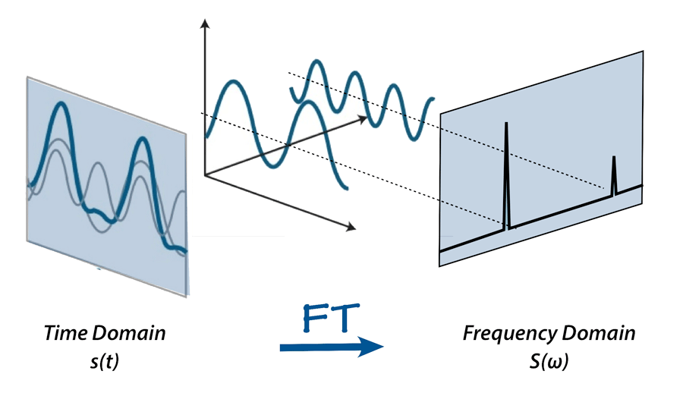
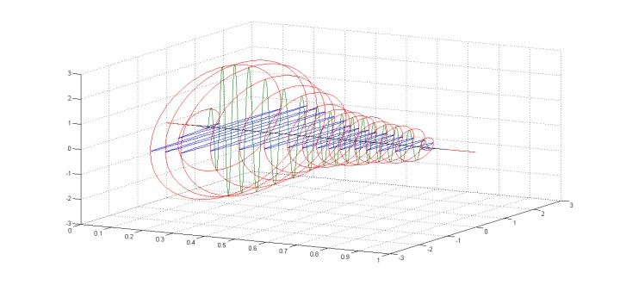
特徵擷取-frequency domain
Feature Extraction & Selection(for XYZ 方向振動、力量訊號)
XYZ Vibration & Frequence
Hilbert Transformation:
將傅立葉轉換的實部訊號與虛部訊號進行包絡，避免訊號的浪費
Fourier Transformation:
將訊號由時域空間轉成頻域空間後，紀錄訊號的位置(頻率)與強度特徵

Slide 8

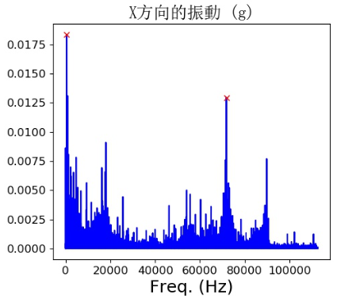
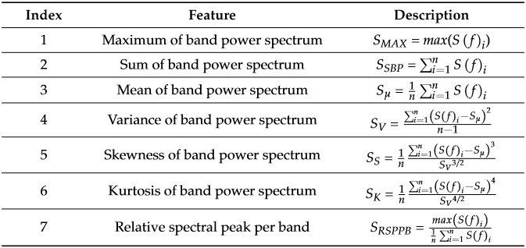
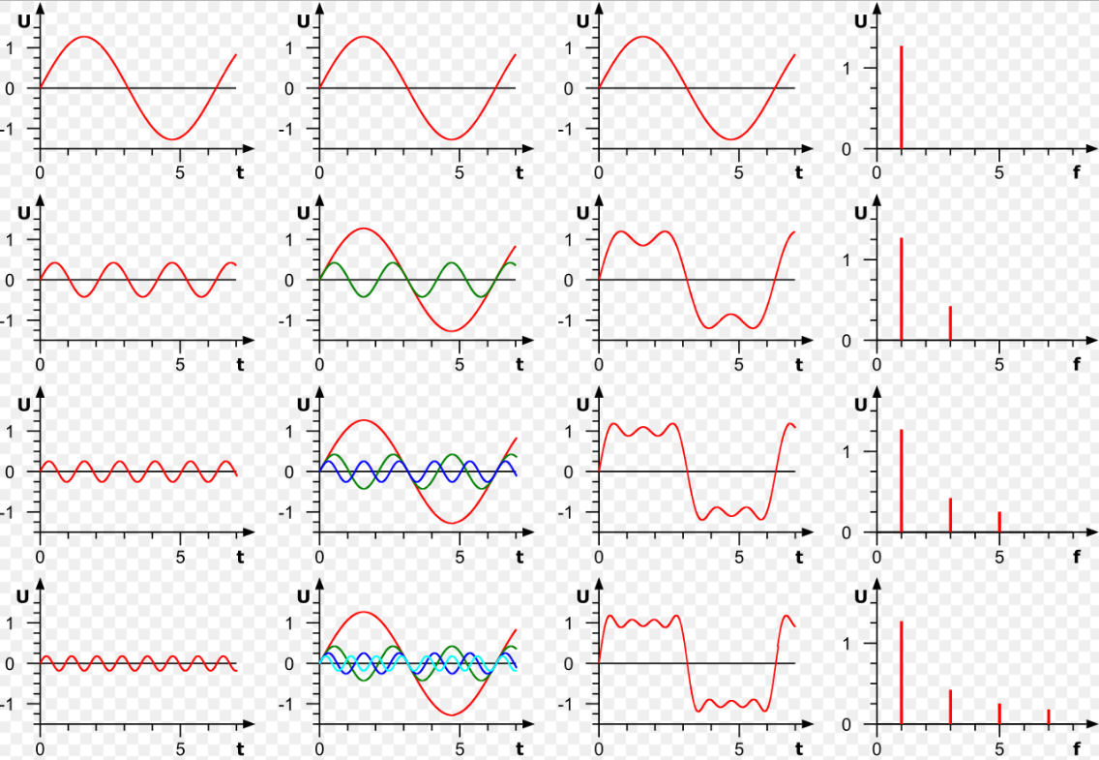
特徵擷取-frequency domain
Freguency Domain (振動與力量)：傅立葉轉換 → 擷取能反映 y 變化的特徵
傅立葉轉換概念:
Time
Freq.

Slide 9
特徵擷取-frequency domain
def featureFD(DF):
n = DF.shape[0]
colnames = DF.columns
factorName = []
rslt = []
for (colIDX,cols) in enumerate(colnames):
# FFT
df = DF.ix[:,colIDX]
yf = np.abs(np.fft.fft(df))/n
yf2 = yf[range(int(n/2))]
# Maximum below 5000 Hz
factorName.append(cols+'_Value1')
rslt.append(np.max(yf2[:5000]))
# Relative Spectral Peak Per Band below 5000 Hz
factorName.append(cols+'_RSPPB1')
rslt.append(np.max(yf2[:5000])/np.mean(yf2[:5000]))
if 2 < colIDX < 6:
# Maximum between 60000 and 80000 Hz
factorName.append(cols+'_Value2')
rslt.append(np.max(yf2[60000:80000]))
# Relative Spectral Peak Per Band between 60000
# and 80000 Hz
factorName.append(cols+'_RSPPB2')
rslt.append(np.max(yf2[60000:80000])/np.mean(yf2[6\
0000:80000]))
return factorName, rslt

Slide 10
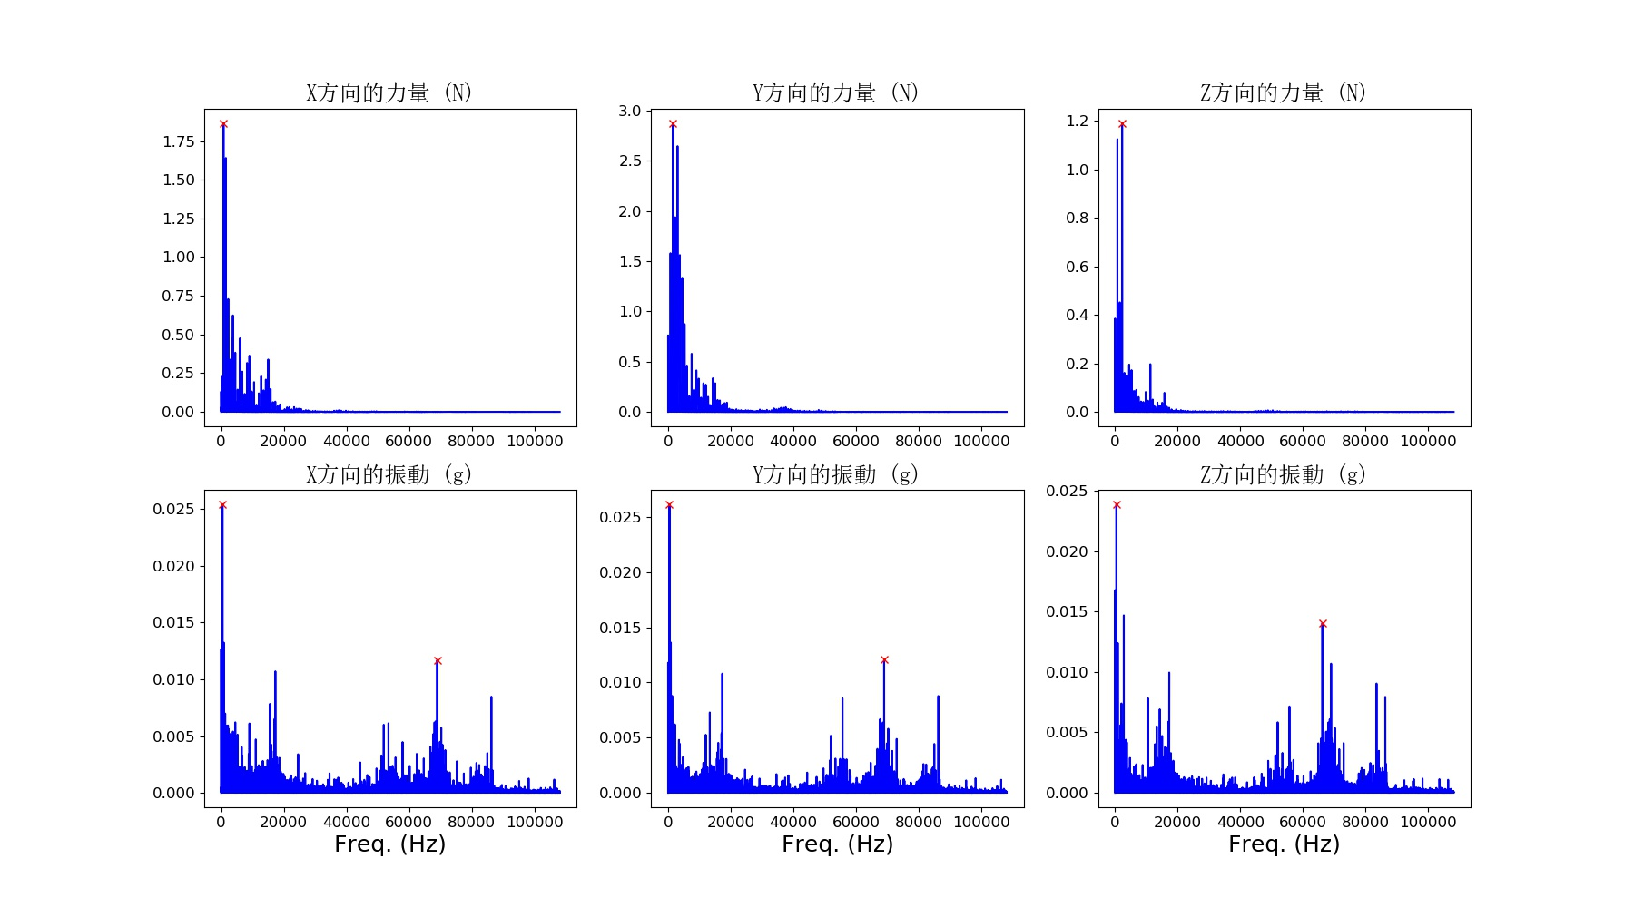
特徵擷取-frequency domain

Slide 11
